Slide 1

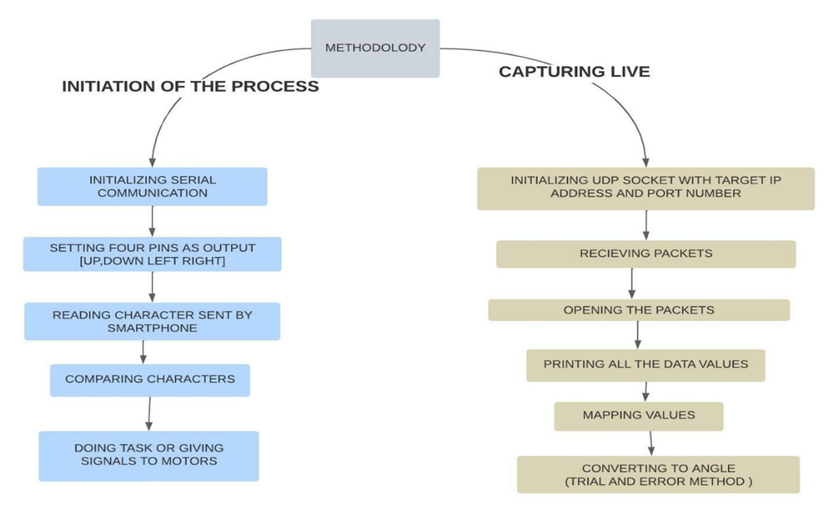
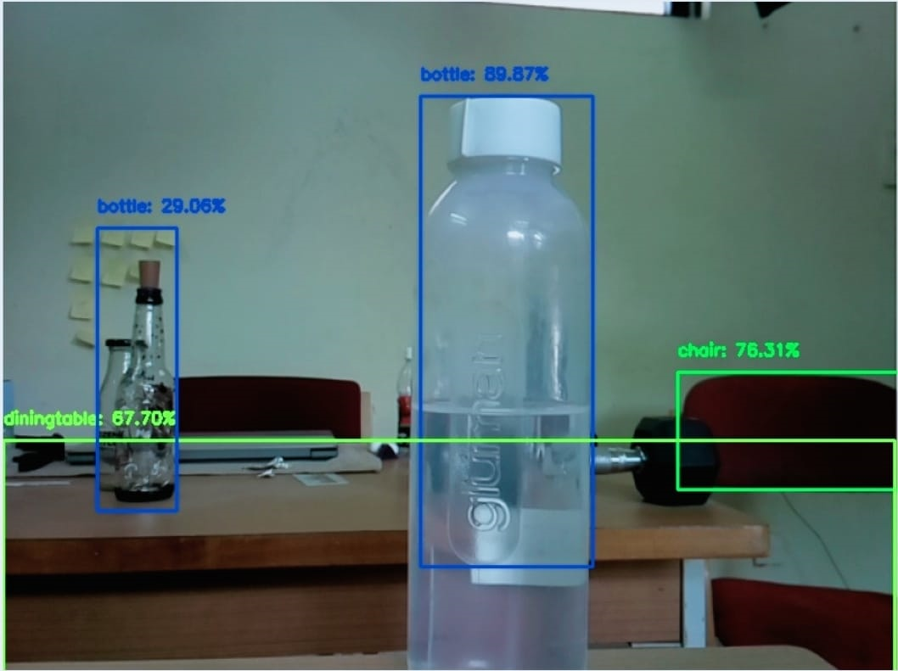
J S S Mahavidyapeetha
J S S Academy of Technical Education, Bengaluru-60
Department of Computer Science and Engineering
Project Exhibition 2023
VIRTUAL TELEPRESENCE ROBOT
Abstract
Objective
Methodology / Process
Virtual reality, robotics, and Augmented reality can team up to develop innovative applications for various organizations. In this project a robot with a camera is placed in a remote location to capture the environment in visual form using Raspberry Pi (RPi). The captured visuals are displayed on the user’s virtual reality (VR) headset. An added feature allows the camera to move in the direction of the user’s head movements and also the visuals show the object detection and classification.This gives the user a real time experience.The virtual telepresence robot can also be moved in any direction through an app installed in the users smartphone.
To design a robot for virtual telepresence.
Using Raspberry pi to achieve the task.
To send data to the modem using Wi-Fi.
This robot can send the live visuals along with obstacle detection to the VR headset.
To receives input from the smartphone via Wi-Fi, and then sends controlling pulse to the servo motors to move the Raspberry Pi camera.
Applications of the Project
Results
Conclusion
The robot can be used in fire and rescue operations.
In the Medical case, at times when the doctor is not able to go on rounds, the robot can be used to check the state of the patient.
As the robot capture the visuals and classify the objects so it can be used in archeology survey.
The robot gives the real time visual experience, it is helpful for users to view real estate virtually.
Integrating features of all the hardware components used have been developed in it. Presence of every module has been reasoned out and placed carefully, thus contributing to the best working of the unit. Secondly, using advanced raspberry pi with the help of growing technology, the project has been successfully implemented. As expected the robot will display the visuals and classify the objects. Thus the project has been successfully designed and tested.
Students Name with USN
Kiran A 1JS19CS076
Mudasir Ahamed 1JS19CS091
Nikhil Raju 1JS19CS102
Prithviraj Patil 1JS19CS125
Guide
Mrs. K. V. Shanthala
Assistant Professor, Department of CSE
JSS Academy of Technical Education
Bengaluru

